Slide 1

Online Auction System

Slide 2

Team Members
Utkarsh Khanna
Sidhant Bidaliya
Siddhesh Thakare
Aastha Singh
Poojal Pithwa
Vineeta Kashyap
Shubham Puri
Ankita Shewale

Slide 3
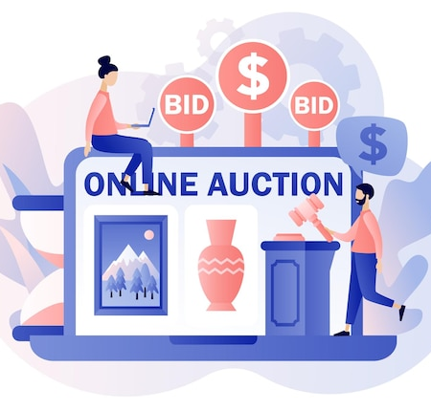
Introduction
This web-based system allows bidding for items. The users who wish to participate in the bidding process must register themselves either a seller or a buyer.

Slide 4
Application Features
A web based app for online bidding
Buyer Portal
Active products for bidding
History of user bought product
Seller Portal
Adding products for bidding
Scheduling an auction
View of Products posted by respective Seller
Scheduling auction
Start and End time of Auction
Logging for each action

Slide 5
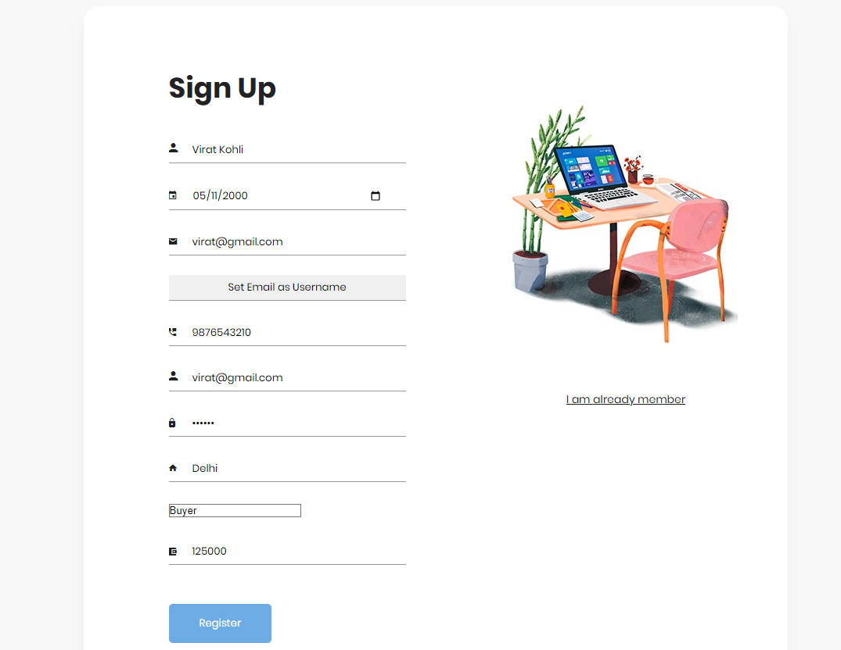
Registration Page

Slide 6
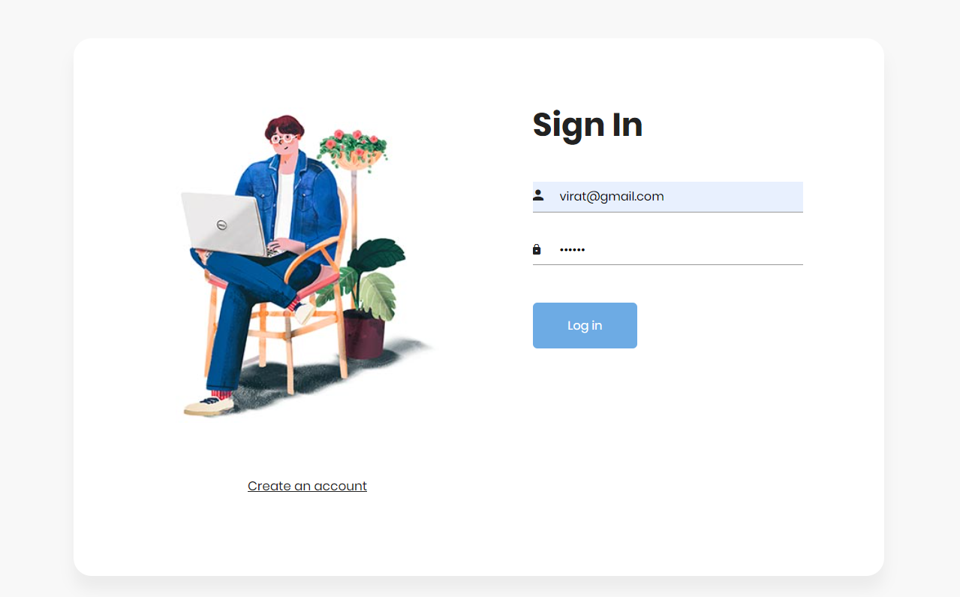
Login Image

Slide 7
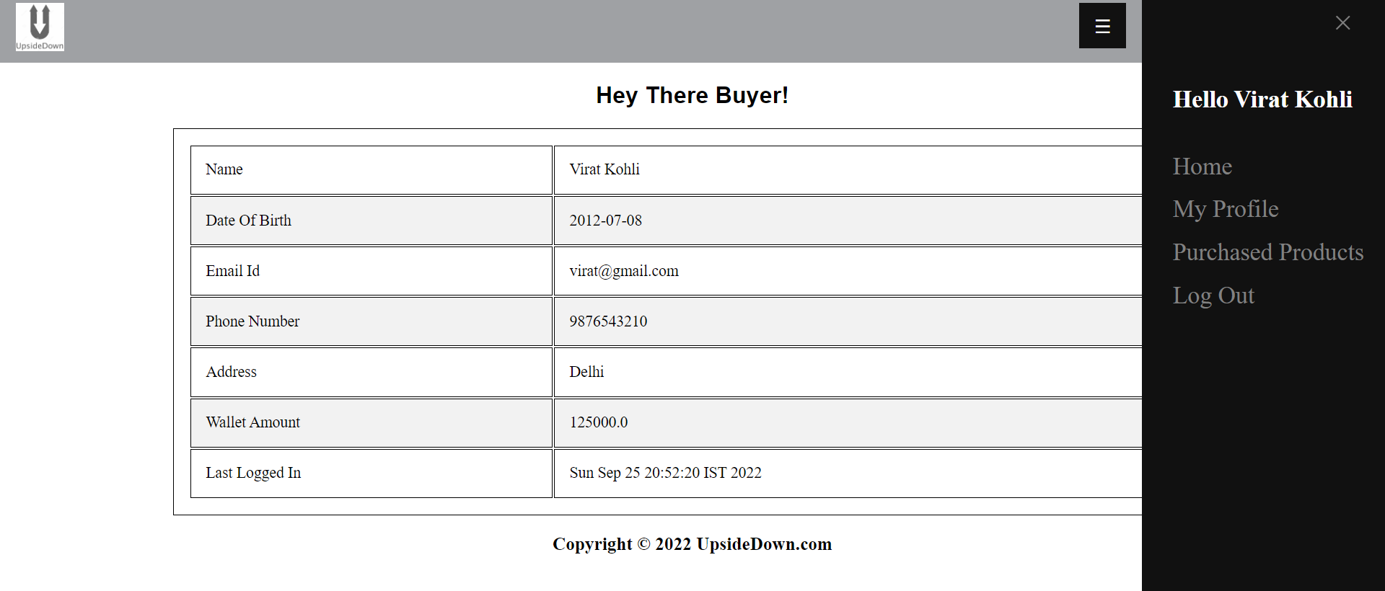
Buyer Profile Page

Slide 8
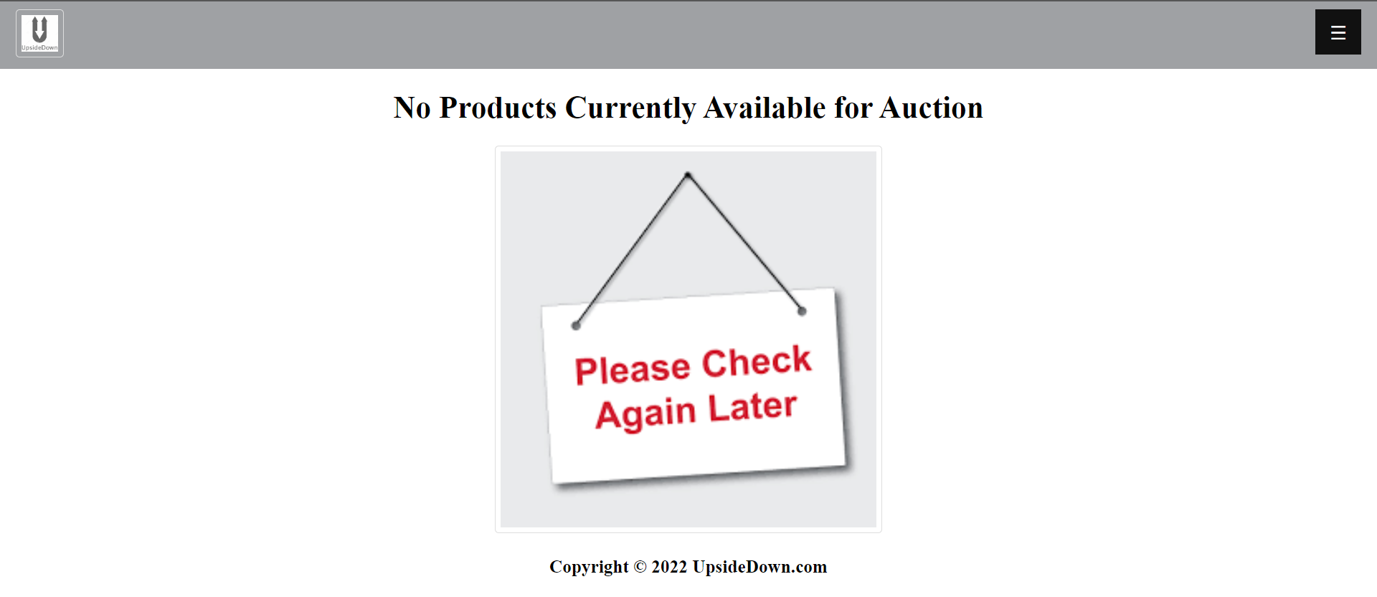
Product List

Slide 9
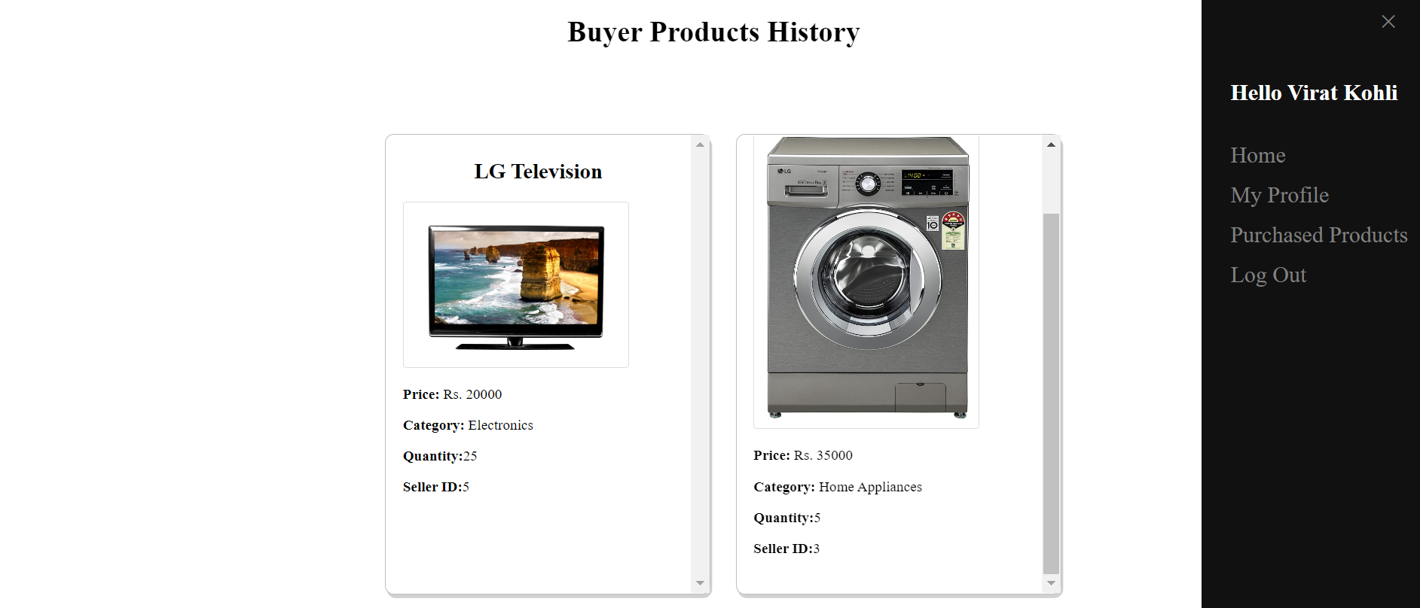
Buyers Product History

Slide 10
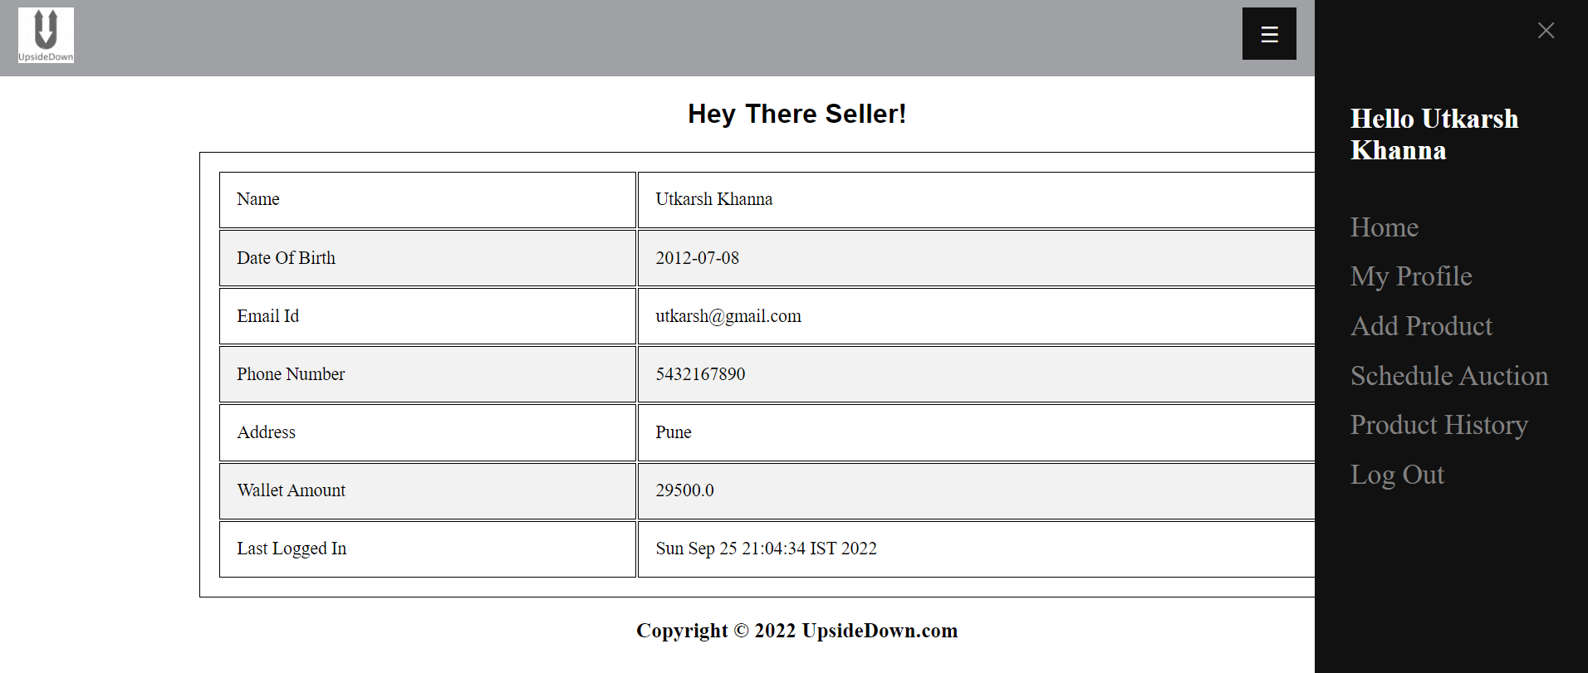
Seller’s Profile Page

Slide 11
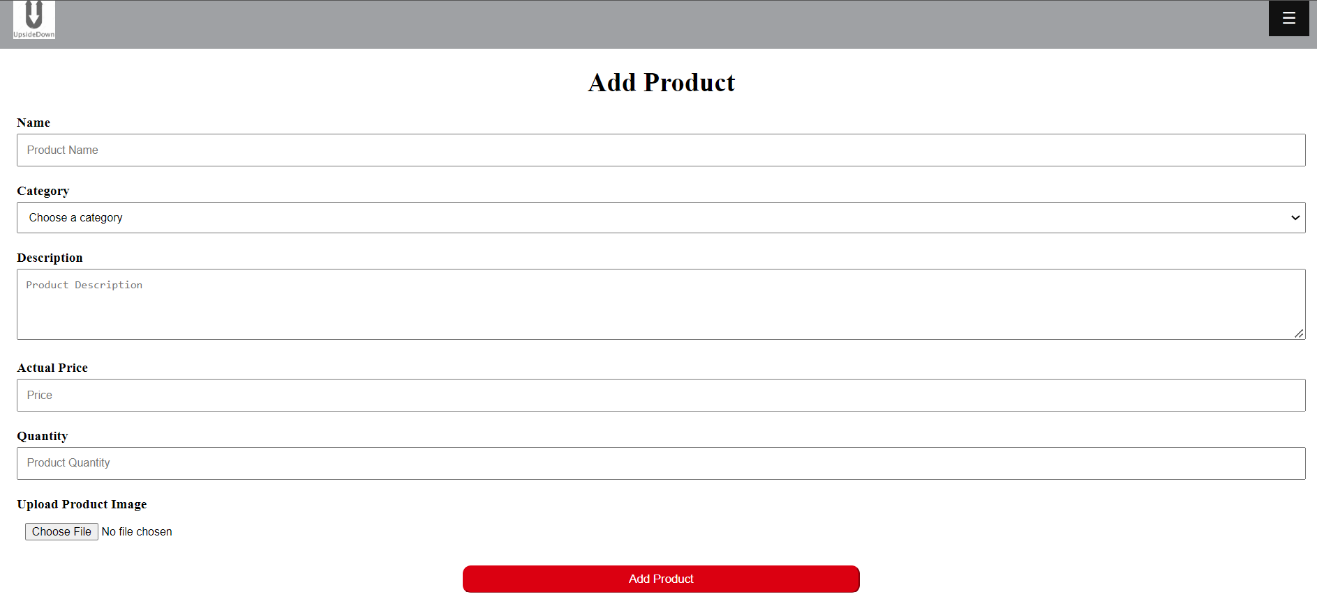
Add Product

Slide 12
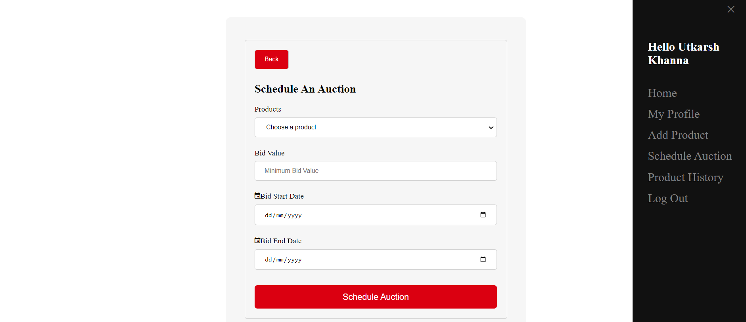
Schedule Auction

Slide 13
Learning
JavaScript
SQL
JavaScript (js) is a light-weight object-oriented programming language which is used by several websites for scripting the webpages.
It is an interpreted, full-fledged programming language that enables dynamic interactivity on websites when applied to an HTML document
Structured Query Language or SQL is a standard Database language which is used to create, maintain and retrieve the data from relational databases like MySQL, Oracle, PostGre, Derby etc.

Slide 14
Learning
Servlets
JSP
They are used to handle the request obtained from the webserver, process the request, produce the response, then send a response back to the webserver.
It stands for Java Server Pages. It is a Web based technology helps us to create dynamic and platform independent web pages.
In this, Java code can be inserted in HTML/ XML pages or both.

Slide 15
Thank You

